Slide 1
DNAQL a data model and query language for databases in DNA
Jan Van den Bussche
joint work with
Joris Gillis, Robert Brijder
Hasselt University, Belgium

Slide 2
Natural Computing
Conventional computing, inspired by nature
Evolutionary systems, algorithms, programs
Parallel systems, swarm computing
Physics as a computation model
Analog computers
Quantum computing
“Wet” computing: use hardware from nature
DNA computing
Reprogrammed bacteria & viruses

Slide 4
DNA Computing: What it is NOT
Solving NP-complete problems
First DNA computing experiment solved a small instance of the Hamiltonian Path problem
[Adleman, Science 1994]
Genetic engineering
DNA computing works with dead material
Synthetic DNA
Bioinformatics
Conventional databases, algorithms to store, analyse genetic information

Slide 5
DNA Computing: What it IS
Use synthetic DNA molecules as data carrier
Programmed nanotechnology
Computation on the DNA carried out by:
Biotechnology laboratory protocols
Enzymes
DNA itself: self-assembly
Computation goes on in:
In vitro: Test tube (watery solution)
DNA chips, diamond surfaces
In vivo (smart medicine)

Slide 6
DNA
Single-stranded DNA molecule:
string over the 4-letter alphabet {A,C,G,T}
the string is called “strand”
the positions are called “bases”

Slide 7
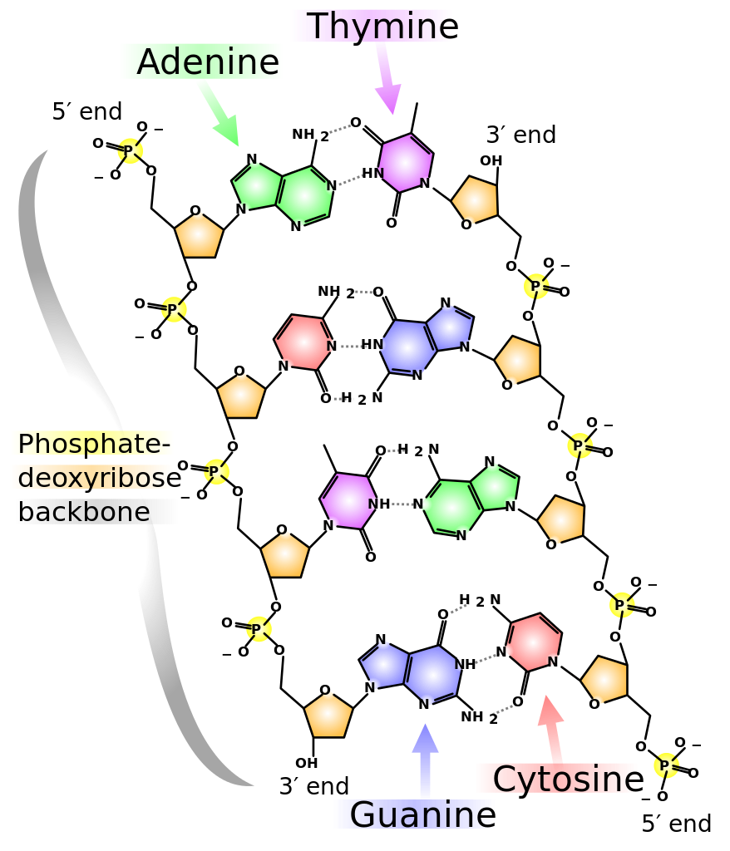
Image credit: Madeleine Price Ball

Slide 8
DNA synthesis and sequencing
Synthesis:
Input: string over {A,C,G,T}
Output: actual DNA single-stranded molecule
Currently limited to length ~ 100
but strands can be concatenated
Sequencing:
Input: DNA single-stranded molecule
Output: string over {A,C,G,T}
Quite reliable, redundancy

Slide 9
Data storage in DNA
Enormous capacity
Theoretical capacity ~ 455 EB per gram
~ 2.2 PB per gram with reliable encode & decode
[Goldman et al., Nature 2013]
Very robust
Long term
1000nds of years
Can be easily copied
Archiving

Slide 10
Databases in DNA?
We need much more than mere archival write/read
Efficient and flexible access
Data model
Query language
DNA computing

Slide 11
Talk Outline
DNA hybridization
Representing tuples, relations in DNA
Doing relational algebra by DNA computing
DNAQL, the language
DNA complexes: the DNAQL data model
Typechecking
Expressive power of DNAQL

Slide 12
Base pairing
Watson-Crick complementarity
A and T are complementary
C and G are complementary
Complementary bases naturally form bonds
“Base pairing”

Slide 14
Complementing strings
Complement of a string:
Reverse the string;
Complement each base.
E.g.

Slide 15
Hybridization
When two single strands containing complementary substrings meet, they hybridize into a double-stranded complex
A
C
T
G
A
A
A
T
G
A
C
T
A
A
Very stable at normal temperatures

Slide 16
Denaturation
Undo base pairing by increasing temperature
A
C
T
G
A
A
A
G
A
C
T
A
T
A
“Melting temperature” is higher for longer consecutive base pairings

Slide 17
Talk Outline
DNA hybridization
Representing tuples, relations in DNA
Doing relational algebra by DNA computing
DNAQL, the language
DNA complexes: the DNAQL data model
Typechecking
Expressive power of DNAQL

Slide 18
Data representation: alphabets
4-letter alphabet is a bit limiting
Can use larger alphabet
Encode each letter by a DNA strand
DNA codewords
Alphabet Λ of value bits
Atomic data values: strings of value bits
Alphabet Ω of attributes
Alphabet Θ of tags: #₁, #₂, …, #₉
Used for punctuation, marking, splitting

Slide 19
Tuples as DNA strings
Combined alphabet Σ = Λ ∪ Ω ∪ Θ
Tuple t over relation schema R = A…B
t = #₂A#₃t(A)#₄…#₂B#₃t(B)#₄
Relation r over R: set of DNA strings
Content of a test tube

Slide 20
Talk Outline
DNA hybridization
Representing tuples, relations in DNA
Doing relational algebra by DNA computing
DNAQL, the language
DNA complexes: the DNAQL data model
Typechecking
Expressive power of DNAQL

Slide 21
Selection
Value bit a
We want to retrieve all tuples from test tube r that contain a
Add complementary strand ā to test tube (in surplus quantities)
Will stick to requested tuples
Retrieve tuples bound to a sticker

Slide 22
Probing, Flush, Cleanup
Immobilize the stickers so they can be retrieved
Tiny magnetic beads
Surface (DNA chip)
Once a tuple sticks, tuple is immobilized too
Insert probes
Hybridize
Flush: wash away tuples that did not stick
Cleanup: recover remaining tuples

Slide 23
DNA chip
a
a
a
a
ā
ā
ā
ā

Slide 24
Cleanup
a
a
a
a
ā
ā
ā
ā

Slide 25
Selection expressed in DNAQL

Slide 26
Cartesian Product
Concatenation:
r x s = { t₁t₂ : t₁ in r & t₂ in s }
Assume r over AB and s over CD
t₁ = #₂A#₃t₁(A)#₄#₂B#₃t₁(B)#₄
t₂ = #₂C#₃t₂(C)#₄#₂D#₃t₂(D)#₄
Use a length-two sticker:

Slide 27
Ligate
Sticker will just hold tuples together temporarily (until denaturation)
Apply ligase (an enzyme) to truly concatenate
Single strand
Single strand
Before ligation
sticker
Concatenation
After ligation
sticker

Slide 28
Cartesian product in DNAQL?
abbreviated

Slide 29
Nonterminating hybridization
Each concatenation still ends with #₄, begins with #₂
Allows chain reaction

Slide 30
Solution (to avoid nontermination)
Add #₅ at end of each tuple of r
Add #₁ at beginning of each tuple of s
let
in let
in
t1
#5
#1
t2

Slide 31
Getting rid of the #₅#₁
Step 4:
Splitting
(Restriction
enzymes)
Step 1:
Blocking
(Polymerase)
Step 2:
Bind to probe
Step 3:
Add sticker
& Ligate

Slide 32
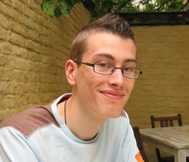
Projection, renaming
Using similar methods
Reshuffling order of attributes
Ingenious procedure
Joris Gillis

Slide 33
Set difference
Subtractive hybridization
Most sensitive and error-prone operation

Slide 34
DNAQL operations so far
Test-tube variables
Probes
Length-two stickers
Union
Difference
Hybridize
Ligate
Flush
Cleanup
Split
Block
Block-from
For-loop
Block-except

Slide 35
Equality selection
Select[A=B](r) = { t in r : t(A) = t(B) }
We can already do:
Select[θ_{a}](r) = { t in r : t contains ‘a’ }
Variant:
Select[A =_{i} B](r) = { t in r : i-th bit of t(A) is ‘a’ }
Add to DNAQL:
Block-except[i] operator, with i a counter variable
For-loop construct to iterate over i

Slide 36
For-loop
DNAQL program for Select[A=B](r):
(assumes only two value bits 0 and 1)

Slide 37
DNAQL

Slide 38
Talk Outline
DNA hybridization
Representing tuples, relations in DNA
Doing relational algebra by DNA computing
DNAQL, the language
DNA complexes: the DNAQL data model
Typechecking
Expressive power of DNAQL

Slide 39
Complexes
Relation in DNA: set of DNA strings
During execution of DNAQL program, more complex structures are formed
Complexes formalized as directed graph
Data model for DNAQL

Slide 40
DNA complex as a graph structure

Slide 41
Types
If complexes are the “instances” in our data model, what are the “schemes”?
Approach:
All data values are carried by strings of value bits
All other nodes are for structuring
Type of a complex:
Replace all value strings by wildcard ‘*’

Slide 42
Type of a relation
relation type
#₂A#₃0011#₄#₂B#₃1100#₄
#₂A#₃0001#₄#₂B#₃1101#₄
#₂A#₃1011#₄#₂B#₃1100#₄ #₂A#₃*#₄#₂B#₃*#₄
#₂A#₃0011#₄#₂B#₃1111#₄
#₂A#₃0000#₄#₂B#₃1111#₄

Slide 43
Talk Outline
DNA hybridization
Representing tuples, relations in DNA
Doing relational algebra by DNA computing
DNAQL, the language
DNA complexes: the DNAQL data model
Typechecking
Expressive power of DNAQL

Slide 44
Well-definedness of DNAQL operations
Implementability by biotechnological operations imposes some preconditions
Always well-defined:
Union
Ligate
Split
Cleanup

Slide 45
Well-definedness conditions
Difference:
single strands only, all same length
Blocking:
complex must be hybridized
Hybridize:
termination
can be statically characterized in terms of absence of certain alternating cycles

Slide 46
Typechecking and inference
Check well-definedness condition for operation statically, based on given input types
Infer type for output, so that next operation can be typechecked

Slide 47
Type inference example
e(x) = hybridize(x ∪ immob(ā))
If x : S then e(x) : T
#₃
*
#₄
#₃
*
#₄
#₃
*
#₄
type S
type T

Slide 48
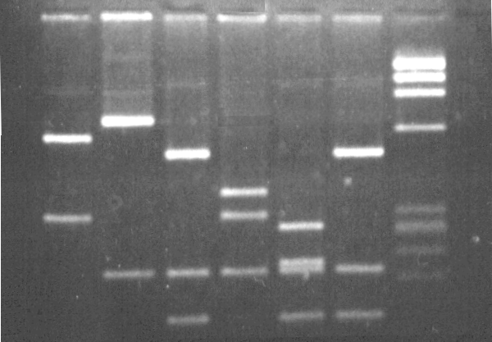
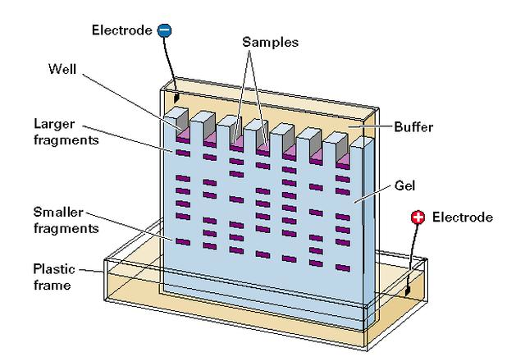
Typechecking Cleanup
Input: any complex (always well-defined)
Output: denature, remove all stickers, probes, keep only longest strands
Gel electrophoresis

Slide 49
Typechecking Cleanup
Consider type S = A*A*A ∪ AA*AA
“Dimension” of a complex:
Number of value bits used for data values
Like word length in a digital computer
Suppose dimension = d
Strands of type A*A*A have length 2d+3
Strands of type AA*AA length 4+d
4+d < 2d+3 for all d
If x : S then Cleanup(x) : A*A*A

Slide 50
Type inference algorithm
Given input types for program:
Decides if “well-typed”
If so, computes result type
Soundness: Well-typed programs always succeed on inputs of given type
Output guaranteed to be of computed result type
Maximality: Converse to soundness
Only for individual operations
Tightness

Slide 51
Talk Outline
DNA hybridization
Representing tuples, relations in DNA
Doing relational algebra by DNA computing
DNAQL, the language
DNA complexes: the DNAQL data model
Typechecking
Expressive power of DNAQL

Slide 52
Expressive power
“String relational algebra”
For-loop over value bits
Value-bit selection Select[A =_{i} a]
Theorem: Every string-relational algebra expression, over given database schema, can be computed by a well-typed DNAQL program.
[Yamamoto et al., DNA12, 2006]
[Yeh et al., Simulation Practice & Theory, 2011]

Slide 53
Converse direction
Theorem: Every well-typed DNAQL program, for given input types, can be simulated in the string-relational algebra
Need to allow finite number of cases on dimension
E.g., cases d < 7; d = 7; d > 7

Slide 54
DNAQL to relational algebra
Type S
*
#₄
#₂
*
Type T
*
#₄
#₂
*
S₁
S₂
If x : S then Hybridize(x) : T
Store values in components of type S₁ in a relation R₁, similar for S₂
Then pairs of values in components of Hybridize(x) can be computed R₁ x R₂
Hybridization = Cartesian product!

Slide 55
Conclusion
We have tried to find the equivalent of relational data model, relational algebra in the world of DNA computing
Made a language by taking “minimal” set of DNA computing operations needed to simulate relational algebra
Made a data model by abstracting the structures arising during the simulation
Resulting DNAQL data model can stand on itself
Satisfying equivalence with string-relational algebra

Slide 56
Outlook
Experimental validation
Simulation
Modeling and analysis of errors
Self-assembly models of DNA computing
Further exploration of database aspects of Natural Computing
Want to learn more? See paper in proceedings for textbooks, conferences, journals, sources, references

